Slide 1
Hashing
EECS 233

Slide 2
Hashing
We have learned several data structures that allow us to store and search for data items using their key fields.
  Unsorted lists and arrays - linear search complexity
  Sorted arrays - log complexity for search; linear for inserts
  Various trees (AVL, B-trees, Heaps)
    Generally logarithmic time complexity
    Rich operations:
      Insert, remove, search, find max/min, top-k

Slide 3
Taking Stock…
The efficiency of the different data structures and operations:
Can we do better than logarithmic complexity?
Hash tables and hashing techniques may allow us to search, insert, and delete an item in sub-logarithmic time, for example, O(1)
Data structure | Search for an item | Insert an item
List (unsorted array)
List (sorted array)
List (linked list)
Binary search tree
Balanced search tree (AVL, B-trees)
Heaps
?

Slide 4
Storing Objects in an Array: Keys and Indexes
Key: a (unique) attribute of object
Index: a position of object in an array
Unsorted arrays:
  Indexes are independent of keys
  Searching is dumb and inefficient
Sorted arrays:
  Indexes are related to keys
  Searching is smart (no longer blind) and efficient (logarithmic)
The hashing idea: treat the key as an index!
  Searching is simple and takes almost no time (constant) = genius
Example: storing grades about students in this class
  Give each student a unique key (integer from 1-150).
  Store the student records in an array, in the position determined by the key
  We can perform both search/update and insertion in O(1) time (for up to 150 students).

Slide 5
Hash Functions
Problem with student grades:
  A student will have different keys in different classes
  What if we used a social security number?
  Nice, but a humongous array!
In many real-world problems, the key attribute has semantic meaning
  Cannot be arbitrarily assigned
  Phone book: key is person’s name, not a unique number
  Web cache: key is a URL
To handle these problems, we use a hash function
  Convert (“map”) keys into array indices
    Domain: the keys
    Range: integers in [0, size-of-array)
  The word “hash”: to chop into small pieces (Merriam-Webster)
    Chopping large domain space into small number of array cells

Slide 6
Hash Tables
Example: student list
  Index = SSN mod 150
Problem: multiple keys mapping to the same index
  Two students with SSN 150-00-0001 and 150-00-0151
    150000001 mod 150 = 150000151 mod 150 = 1
  We need techniques to handle such cases called collisions
The resulting data structure is known as a hash table
  Hash function
  Array
  Procedures and data structures to handle collisions
Operations:
  Insert
  Remove
  Contains (search)
  isEmpty, makeEmpty, etc.
  No findMax!

Slide 7
Hash Functions Desiderata
Example 1: _x0013_Salary as key
  10-workers shop
  Keep employees record in hash table with (salary mod 10) hash function
  What if all salaries are multiple of 10K? - Bad function!
  What if all salaries are multiple of 2K? - Better function!
  Random salaries - Good function!
Example 2: String as key (e.g., Webster)
  keys = character strings composed of lower-case letters
  hash function:
    h(key) = (the byte sum of all characters) mode table-size
    example: h(“cat”) = ( ‘c’ + ‘a’ + ‘t’) mod 500000
    But: assume words are mostly up to 20 character-long
    Max sum is 127*20 = 2540; any larger table is of no use!
Requirements for good hash functions:
  Full table size utilization
  Even (“uniform”) key mapping throughout the table
    Utilizing known key distribution in the objects
    Making hash function “random” - the distribution of keys is independent of distribution of indexes they map to

Slide 8
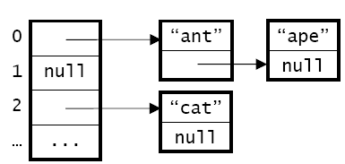
Handling Collisions with Chaining
If multiple items are assigned the same hash code, “chain” them together. Each position in the hash table serves as a bucket that is able to store multiple data items.
Implementation: a linked list
  disadvantage: memory overhead for the references
Alternative implementation: each bucket is itself an array (or points to an array)
  disadvantages:
    large buckets can waste memory
    a bucket may become full; overflow occurs when we try to add an item to a full bucket

Slide 9
Operations with Chaining
Search for an item
  Need to traverse the corresponding linked list or array
  To guarantee short lists, the number of hash table slots should be of the same order as the total number of items
  Load factor: ratio of the number of items to the number of hash table slots
Inserting an item
  Insertion in a linked list or array
  New list node must be allocated
  Array size need to be dynamically adjusted
Removing an item
  The size of an almost-empty array needs to be adjusted
  List node must be garbage-collected

Slide 10
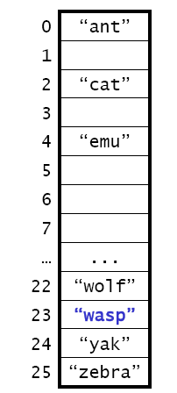
Handling Collisions with Open Addressing
When the position assigned by the hash function is occupied, find another open position - a process called probing.
  Example: h(key) = <character encoding of first char> – <encoding of ‘a’>
  “wasp” has a hash code of 22, but it ends up in position 23, because position 22 is occupied.
The hash table also performs probing to
search for an item.
  example: when searching for “wasp”, we look
  in position 22 and then look in position 23
  we can only stop a search when we reach an
  empty position

Slide 11
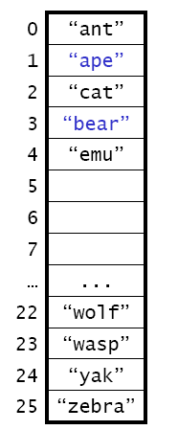
Linear Probing for Open Addressing
Probe sequence: h(key), h(key) + 1, h(key) + 2, …, wrapping around as necessary.
  Example:
    “ape” (h = 0) would be placed in position 1,
    because position 0 is already full.
    “bear” (h = 1): try 1, 1 + 1, 1 + 2 – open!
    where would “whale” end up?
Advantage: if there is an open position, linear
probing will eventually find it.
Disadvantage: “clusters” of occupied positions develop
  Increases the lengths of subsequent probes.
  As load factor increases, both search and insert
times look increasingly linear!

Slide 12
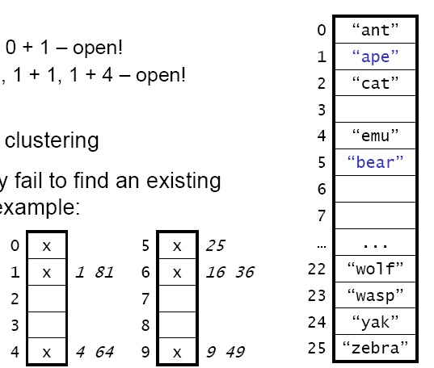
Quadratic Probing for Open Addressing
Probe sequence: h(key), h(key) + 1, h(key) + 4, h(key) + 9, …, wrapping around as necessary.
  the offsets are perfect squares: h + 1², h + 2², h + 3², …
  Example:
    “ape” (h = 0): try 0, 0 + 1 – open!
    “bear” (h = 1): try 1, 1 + 1, 1 + 4 – open!
    “whale”?
Advantage: reduces clustering
Disadvantage: it may fail to find an
existing open position.
Example:
  table size = 10
  x = occupied
  trying to insert a key
  with h(key) = 0
Theorem: If the load factor is less than 50% and the table size is prime,
a new item can always be inserted

Slide 13
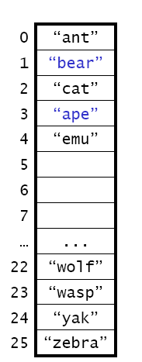
Double Hashing for Open Addressing
Use two hash functions:
  h1 computes the hash code
  h2 computes the increment for probing
  Probe sequence: h1, h1 + h2, h1 + 2*h2, …
Example:
  h1 = our previous function h
  h2 = number of characters in the string
  “ape” (h1 = 0, h2 = 3): try 0, 0 + 3 – open!
  “bear” (h1 = 1, h2 = 4): try 1 – open!
  “whale”?
Combines the good features of linear and
quadratic probing:
  reduces clustering
  Theorem: will find an open position if there is one, provided the table size is a prime number.
  Disadvantage: the need for two hash functions

Slide 14
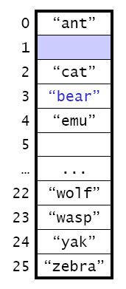
Removing Items with Open Addressing
Consider the following scenario using linear probing
  insert “ape” (h = 0): try 0, 0 + 1 – open!
  insert “bear” (h = 1): try 1, 1 + 1, 1 + 2 – open!
  remove “ape”
  search for “ape”: try 0, 0 + 1 – no item
  search for “bear”: try 1 – no item, but “bear”
  is further down in the table
  Cannot tell if it is not in the table
Any difference with quadratic probing or double hashing?
ape

Slide 15
Removing Items with Open Addressing
When we remove an item from a position, we need to leave a special value in that position to indicate that an item was removed.
Three types of positions: occupied, empty, “removed”.
When we search for a key, we stop probing when we encounter an empty position, but not when we encounter a removed position.
  How to search for “ape”?
  How to search for “bear”?
We can insert items in either empty or removed positions.
REMOVED

